Slide 1
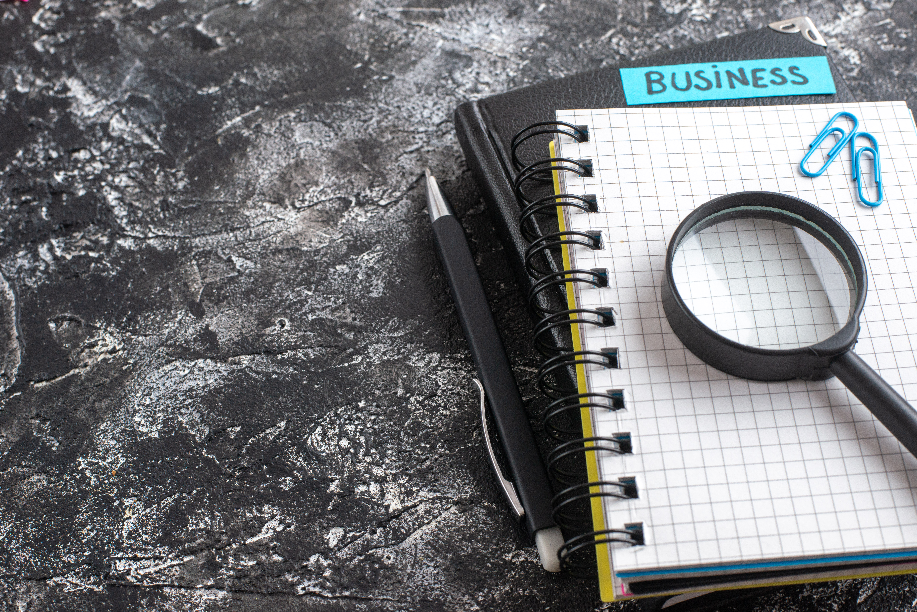

The Great Indian Smartphone Protection Crisis

Slide 2




RESEARCH OBJECTIVE
Why Smartphone Protection's Moment Is Now
Smartphones have quietly become the most expensive, most-used and longest-held device in an Indian household, which makes protecting them a bigger question than ever.
The Inflection Point
Costlier phones, held for longer, are exactly the conditions that make protection plans matter most. If there is a moment for the category to inflect, it is now.
40–50%
~40 months
Rise in average smartphone prices in India in this year
New replacement cycle, up from once every couple of years
OneAssist has been a pioneer in India's smartphone protection category. To understand the category truth, how consumers actually use, damage, replace and protect their smartphones, and where the secondary market fits in, OneAssist partnered with Hansa Research on this nationwide study.
ONEASSIST × HANSA RESEARCH | THE GREAT INDIAN SMARTPHONE PROTECTION GAP
2

Slide 3




METHODOLOGY
How We Did The Research
A blind, structured study conducted independently by Hansa Research on behalf of OneAssist.
Surveyed via the Hansa Cheetah Panel using a structured, client-approved questionnaire
Blind study: Respondents were told only that it was on behalf of Hansa Research
Hansa Research is one of India's leading full-service market research and consumer insight agencies, with deep experience running large-scale, syndicated and custom studies across consumer, retail and technology categories nationwide.
Interviews in English, with a length of interview (LOI) of 10–12 minutes
Smartphone owners aged 18–45, device worth ₹10K+, and the primary decision-maker or user of it
Target Group
• Smartphone users, 18–45 years, across Metro + Non-Metro (Tier 1 & 2) India
• Owns a smartphone worth ₹10,000+, and is a primary decision-maker / user of the device
• Coverage across North, South, East and West India
ONEASSIST × HANSA RESEARCH | THE GREAT INDIAN SMARTPHONE PROTECTION GAP
3

Slide 4
SAMPLE & COVERAGE
1,260 Smartphone Users. Every Corner Of India.
A representative mix across geography, gender, age and phone value, so the findings speak for India, not just its metros. (Total sample: 1,260)
Geography
Gender
Age Group
Current Phone Value
Metro 48% Non-Metro 52%
Men 80% Women 20%
Zone Split
Current Phone Ownership
70% use their smartphone heavily throughout the day
North 27% · East 25%
South 24% · West 24%
<1 yr 45% · 1-2 yrs 36%
2+ yrs 19%
ONEASSIST × HANSA RESEARCH | THE GREAT INDIAN SMARTPHONE PROTECTION GAP
4

Slide 5
01
SECTION 01
Smartphone Dependency
How deeply, and in how many ways, India now relies on its phone
ONEASSIST × HANSA RESEARCH | THE GREAT INDIAN SMARTPHONE PROTECTION GAP
5

Slide 6
SMARTPHONE DEPENDENCY
Gen Z Runs their Life Through The Phone
For 18 -30-year-olds, the phone is a commerce and connection device first. 71% use it for shopping and food delivery and 80% for communication, both the highest of any age group. Mobile commerce in India is a youth-led habit.
Daily Usage Intensity (All India)
Top Activities Among 18-25 Year-Olds (not mutually exclusive)
● Heavy · 70%
● Moderate · 25%
● Only when required · 5%
ONEASSIST × HANSA RESEARCH | THE GREAT INDIAN SMARTPHONE PROTECTION GAP
6

Slide 7


SMARTPHONE DEPENDENCY
Women Are India's Most Dependent Smartphone Users
Across both gender and geography, the same signal repeats: the more plugged-in the group, the more central the phone becomes to daily life.
Women Lead On Heavy Daily Use
77% of women use their phone heavily throughout the day, versus 68% of men — the widest usage gap in the study.
68%
77%
MEN
WOMEN
Metro India Is More Plugged-In
76% of Metro consumers use their phone heavily throughout the day, compared with 64% in Non-Metro India.
64%
76%
NON-METRO
METRO
ONEASSIST × HANSA RESEARCH | THE GREAT INDIAN SMARTPHONE PROTECTION GAP
7

Slide 8

02
SECTION 02
The Damage Epidemic
How, where and why India's smartphones actually break
ONEASSIST × HANSA RESEARCH | THE GREAT INDIAN SMARTPHONE PROTECTION GAP
8

Slide 9
THE DAMAGE EPIDEMIC
Damage & Breakdown Are The Biggest Worry
Combine the fear of a phone breaking with it simply not working, and that beats even the fear of it going out of date — the two damage-linked fears split differently by gender.
Biggest Fear Related To One's Smartphone
Men vs Women
Fear
Men
Women
Breaks or stops working
52%
60%
Will get stolen
15%
23%
Outdated too quickly
32%
16%
For Both Men And Women, A Broken Or Non-Working Phone Is The Single Biggest Worry
Combined, it's the top fear for both — 52% of men and 60% of women, well ahead of outdated tech or theft.
ONEASSIST × HANSA RESEARCH | THE GREAT INDIAN SMARTPHONE PROTECTION GAP
9

Slide 10

THE DAMAGE EPIDEMIC
Damage Is Now A Way Of Life
Smartphone damage in India is not a rare accident. It is now part of the ownership journey.
82%
72%
of Indians have dropped their phone at least once
have already suffered accidental damage to their device
8 in 10 Indians have dropped their phone. 7 in 10 have already suffered accidental damage.
Internal data: despite real gains in phone durability, service requests have stayed flat for the last 2–3 years — the damage epidemic isn't cooling off.
ONEASSIST × HANSA RESEARCH | THE GREAT INDIAN SMARTPHONE PROTECTION GAP
10

Slide 11
THE DAMAGE EPIDEMIC
The Biggest Risk Is Everyday Life
The pocket is the phone's biggest enemy. 36% of all damage happens simply because the phone falls from a pocket or bag. The everyday commute, walk and drive account for far more breakage than any outdoor or adventure activity.
Most Common Reason For Phone Damage
ONEASSIST × HANSA RESEARCH | THE GREAT INDIAN SMARTPHONE PROTECTION GAP
11

Slide 12
THE DAMAGE EPIDEMIC
For Women, Damage Happens Closer To Home
Men's damage skews to active, on-the-go lifestyles. Women's is more likely to happen in family and home settings, where child or pet-related damage is over 3x more common (11% vs 3%).
Most Common Reason For Phone Damage · Men vs Women
Overall Accidental Damage
71%
79%
MEN
WOMEN
Men break phones on the move: walking, running, driving and outdoor trips. Women's damage clusters at home, where child or pet accidents and liquid exposure (19% vs 14% for men) run higher.
ONEASSIST × HANSA RESEARCH | THE GREAT INDIAN SMARTPHONE PROTECTION GAP
12

Slide 13
THE DAMAGE EPIDEMIC
The Most Common Damage Is The Screen — But It Rarely Stops There
A cracked screen is the most visible outcome, at 70%. But it rarely travels alone: 41% report the phone stopping completely, and battery, camera and charging-port failures each affect roughly a third, stacking up inconvenience and repair cost.
Type Of Phone Damage Experienced · Not mutually exclusive
ONEASSIST × HANSA RESEARCH | THE GREAT INDIAN SMARTPHONE PROTECTION GAP
13

Slide 14

03
SECTION 03
The Aftermath
What happens in the minutes, months and years after a phone breaks
ONEASSIST × HANSA RESEARCH | THE GREAT INDIAN SMARTPHONE PROTECTION GAP
14

Slide 15

THE AFTERMATH
Smartphone Damage Triggers Real Emotional Reactions
For millions of Indians, a damaged phone is not just a repair bill. It is panic, conflict, and disrupted plans.
35%
24%
15%
panicked after dropping their phone
fought with someone over phone damage
cancelled plans because their phone was damaged
ONEASSIST × HANSA RESEARCH | THE GREAT INDIAN SMARTPHONE PROTECTION GAP
15

Slide 16

THE AFTERMATH
When It Breaks, India tries Jugaad
Faced with high repair costs, India turns to jugaad. 36% ignore cracks for months, 30% try the rice trick for water damage, and 28% reach for tape or temporary fixes rather than pay to repair.
What People Have Done Because Of Their Smartphone
The Cracked-Mirror Irony
In Indian tradition, a cracked mirror or screen is often seen as a bad omen. Yet the high cost of repair or replacement means millions carry a cracked screen anyway, sometimes for months, sometimes for years.
ONEASSIST × HANSA RESEARCH | THE GREAT INDIAN SMARTPHONE PROTECTION GAP
16

Slide 17

04
SECTION 04
Replacement & Upgrade
Why India actually buys its next phone, and what happens to the old one
ONEASSIST × HANSA RESEARCH | THE GREAT INDIAN SMARTPHONE PROTECTION GAP
17

Slide 18
REPLACEMENT & UPGRADE
Two In Five Upgrades Are Forced, Not Chosen
Group the reasons behind a phone purchase into wanted upgrade versus forced replacement and the split is near even. 42% of purchases follow a failure, damage, degraded battery or loss, not a want.
UPGRADE
REPLACEMENT
58%
42%
Wanted better features (20%) · Needed an upgrade for work/studies (17%) · Wanted a more premium phone (12%) · Excited by a new launch (10%)
Old phone stopped working (13%) · Damaged their old smartphone (12%) · Battery life had degraded (12%) · Lost their old smartphone (5%)
An unplanned expense households don't budget for
ONEASSIST × HANSA RESEARCH | THE GREAT INDIAN SMARTPHONE PROTECTION GAP
18

Slide 19
REPLACEMENT & UPGRADE
Old Phones Never Really Die
Split into what happens to an old phone, it's an even split: half stays close to the owner, half moves on to someone or somewhere else. Very few are ever recycled or thrown away.
KEEP IT WITH THEM
PASSING IT ON
50%
50%
Keep it as a personal spare phone (23%) · Give it to a family member or friend (27%)
Exchange/trade it in for a new phone (31%) · Sell it online or offline (16%) · Recycle/dispose of it (3%)
Only 3% ever recycle or dispose of an old phone
ONEASSIST × HANSA RESEARCH | THE GREAT INDIAN SMARTPHONE PROTECTION GAP
19

Slide 20

05
SECTION 05
The Great Protection Crisis
High awareness, real fear, low adoption, and why
ONEASSIST × HANSA RESEARCH | THE GREAT INDIAN SMARTPHONE PROTECTION GAP
20

Slide 21

THE GREAT PROTECTION CRISIS
Awareness Is High. Adoption Isn't.
84% know protection plans exist and 36% have bought one at some point, a meaningful base. The real gap shows up today: a market attach rate of just 6–8%.
84%
36%
6–8%
have heard of smartphone protection / insurance plans
have ever bought one
current market attach rate on new phone sales
36% have bought protection before, a real base. The gap is today's 6–8% attach rate: awareness and past intent are not converting into current cover.
ONEASSIST × HANSA RESEARCH | THE GREAT INDIAN SMARTPHONE PROTECTION GAP
21

Slide 22
THE GREAT PROTECTION CRISIS
What's Holding The Protection Category Back
Cost and comprehension lead the barriers, but the deeper drag is trust: 42% do not trust the claims process and 43% do not understand what the benefits actually are. A further 33% were simply never offered a plan at purchase.
Barriers To Buying Smartphone Insurance/Protection Plans (not mutually exclusive)
ONEASSIST × HANSA RESEARCH | THE GREAT INDIAN SMARTPHONE PROTECTION GAP
22

Slide 23
THE GREAT PROTECTION CRISIS
No Protection Plan — But Plenty Bought To Save The Phone Anyway
Only 36% have ever bought a formal protection plan, yet 73% use a screen protector and 66% a phone case. The fear is real; the spending just goes elsewhere.
Protective Measures Used For Current Smartphone (not mutually exclusive)
The underlying risk has not gone away: internal claims incidence has not reduced over time, which is exactly why the informal, DIY protection habit persists.
ONEASSIST × HANSA RESEARCH | THE GREAT INDIAN SMARTPHONE PROTECTION GAP
23

Slide 24

THE GREAT PROTECTION CRISIS
The Store Counter Still Wins Trust
Retailers remain India's most powerful protection influencer, ahead of e-commerce and social media.
Information Sources About Protection/Insurance Plans
Sales Remain Assisted
Smartphone protection is still overwhelmingly sold face-to-face at the point of purchase, not self-serve online, which is exactly why the retailer counter dominates as the trusted source.
ONEASSIST × HANSA RESEARCH | THE GREAT INDIAN SMARTPHONE PROTECTION GAP
24

Slide 25
THE GREAT PROTECTION CRISIS
OneAssist Leads Brand Awareness
OneAssist is the most recognised protection brand at 53%, well ahead of its four largest competitors (47%, 33%, 27% and 26%). Awareness for most brands runs higher among Metro consumers than Non-Metro.
Awareness Of Brands
ONEASSIST × HANSA RESEARCH | THE GREAT INDIAN SMARTPHONE PROTECTION GAP
25

Slide 26

06
SECTION 06
Recommerce
Where the protection conversation flips: trust, not cost, becomes the deciding factor for pre-owned phones
ONEASSIST × HANSA RESEARCH | THE GREAT INDIAN SMARTPHONE PROTECTION GAP
26

Slide 27
RECOMMERCE
New Phones: Afterthought. Pre-Owned: Dealmaker.
4 in 10 (42%) Indians have already bought a second-hand smartphone. As that market grows, a protection plan increasingly becomes the deciding factor, not just a nice-to-have.
Who's Buying Pre-Owned
42%
BY AGE
41-45 yrs
33%
31-40 yrs
24%
26-30 yrs
24%
have ever purchased a second-hand / pre-owned smartphone
18-25 yrs
19%
BY GEOGRAPHY
Non-Metros
64%
Metros
36%
BY GENDER
Men
63%
Women
37%
ONEASSIST × HANSA RESEARCH | THE GREAT INDIAN SMARTPHONE PROTECTION GAP
27

Slide 28
RECOMMERCE
Value Remains The Single Biggest Trigger
Affordability is the decisive pull: 51% would consider a second-hand phone mainly for value for money, and 45% for the chance to own a premium model at a lower price. Savings, not sustainability or trust, drive the decision.
Top Reasons To Consider A Pre-Owned Smartphone (not mutually exclusive)*
*Those who have never owned a second-hand/pre-owned smartphone
ONEASSIST × HANSA RESEARCH | THE GREAT INDIAN SMARTPHONE PROTECTION GAP
28

Slide 29
RECOMMERCE
A Trust Deficit Holds The Market Back
The top concerns are all about trust, not price: quality or battery condition (55%), hidden defects (51%) and authenticity (49%). The trust deficit runs higher among younger and metro buyers, while women are the most likely to prefer a brand-new phone.
Concerns With Purchasing A Second-Hand / Pre-Owned Smartphone (not mutually exclusive)
ONEASSIST × HANSA RESEARCH | THE GREAT INDIAN SMARTPHONE PROTECTION GAP
29

Slide 30

RECOMMERCE
Protection Flips The Equation
Where cost drives new-phone protection decisions, trust drives pre-owned ones, and protection plans are how that trust gets built.
44%
30%
70%
are concerned about lack of warranty/protection on a pre-owned phone
say the availability of a warranty/protection plan would make them consider buying pre-owned
believe protection is even more important for pre-owned phones than for new ones
Among those who've never owned a pre-owned smartphone
ONEASSIST × HANSA RESEARCH | THE GREAT INDIAN SMARTPHONE PROTECTION GAP
30

Slide 31





SUMMARY
The Big Picture
Smartphones have become India's most essential personal device, but protection habits have not kept pace with dependence, damage, or cost.
70%
82%
72%
84%
use their smartphone heavily every day
have dropped their phone at least once
have suffered accidental damage
know smartphone protection plans exist
36%
42%
70%
#1
have ever actually bought one
have bought a pre-owned smartphone
say protection matters more for pre-owned phones
OneAssist, most recognised protection brand
ONEASSIST × HANSA RESEARCH | THE GREAT INDIAN SMARTPHONE PROTECTION GAP
31

Slide 32

THE WAY FORWARD
How OneAssist Is Bridging The Gap
Three barriers stand between awareness and adoption for smartphone protection — closing them has been core to OneAssist's approach as the category's pioneer.
THE THREE BARRIERS TO ADOPTION
Trust In The Claims Process
Understanding Of Benefits
Cost
THE BACKSTORY
A Rocky Start To The Category, And Why It Made Us Work Harder
The protection category had a difficult start in the early 2010s, when a few players exited abruptly — leaving customers and retailers stranded mid-claim. As a pioneer of the category, OneAssist had to work doubly hard to rebuild the ecosystem's trust from the ground up.
That work continues today through tech-led interventions across all three barriers — trust, understanding, and cost.
ONEASSIST × HANSA RESEARCH | THE GREAT INDIAN SMARTPHONE PROTECTION GAP
32

Slide 33
THE WAY FORWARD
Tech-Led Interventions, Purpose-Built For Trust
Six initiatives, each targeting one of the three barriers to adoption.
TRUST IN CLAIMS
UNDERSTANDING
AFFORDABILITY
SONIC — AI Claims Decisioning
Proactive Communication
Protection Plans On EMI
In-house AI reviews document-less claims and delivers a verdict in under 10 seconds — replacing the old paperwork-heavy reimbursement model.
We proactively tell customers what's covered and what isn't, cutting through common confusion — like the perception overlap between the benefits of Accidental Damage & Liquid Damage (ADLD) protection and an Extended Warranty (EW).
Piloting protection plans on EMI with partners — so the upfront cost of a plan stops being the reason someone walks away from it.
Transparent Repair Tracking
Real-time tracking shows customers exactly what's happening with their phone, including estimates shared directly from Brand-Authorised Service Centres.
‘No-Questions-Asked’ Programmes
Built to counter the fear of rejection — meet the basic requirements, and the claim is honoured.
Service Guarantee
Clear upfront communication on coverage is one of the simplest, highest-leverage ways to close the understanding gap.
“Too expensive” was the #1 barrier to adoption (44%). Financing options directly target that.
Miss our repair timeline, and customers get their protection-plan cost refunded — while their plan stays active.
ONEASSIST × HANSA RESEARCH | THE GREAT INDIAN SMARTPHONE PROTECTION GAP
33

Slide 34
Thank You
For media queries and the full dataset, please reach out to the OneAssist communications team.

